Slide 1
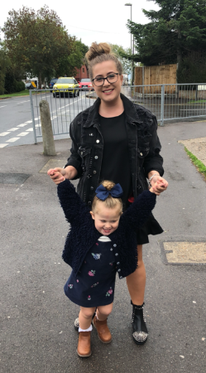
Hello 5S!
How are you all? Very well, I hope!
We haven’t been a class together for almost 4 months – such a long time!
It’s been wonderful to catch up with most of you on the telephone and to see some of your lovely faces in school. I have enjoyed receiving and reading many letters that lots of you have posted to me – so, thank you very much!
I trust that you have been busy completing the Year 5 learning and I have loved seeing some of the things you have emailed in or completed in school. Has your learning been added to the QI gallery on our website yet? As well as the learning you’ve been completing, what else have you been doing in your spare time? Have you developed any new skills or hobbies? What has been your favourite activity? How have you passed the time?
I have been on lots of walks and bike rides with my daughter and baking lots of cakes. I have also been in school teaching a group of 9 foundation children - it is very different to teaching Year 5!
Please send me a slide (like mine – see next slide) with a picture and short description or message that I can share with all the other children in our class. You can change the colours and fonts and add pictures. If you cannot use the PowerPoint slide template, just send me a word document or text in an email and an image and I will create the slide for you. Remember to get your parent’s permission if you want to add any pictures with you or your family in them.
Please email it to me by Friday this week and I will put all the slides together and email a PowerPoint back next week with all the messages and images from 5S.
I cant wait to see all of your pages and read about your time away from school.
Love from
Miss Salt xx

Slide 2
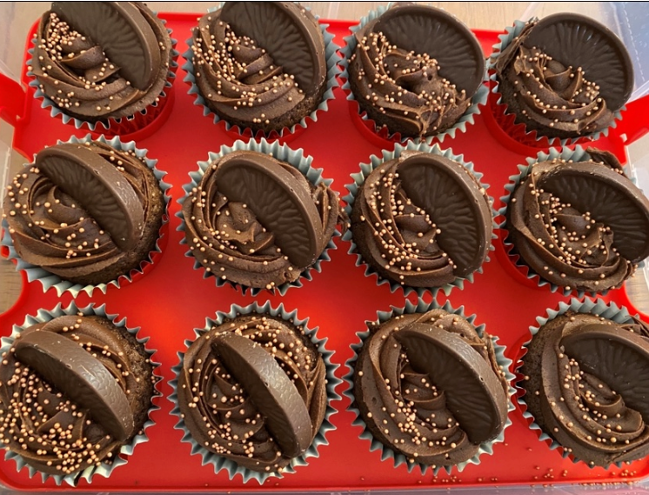
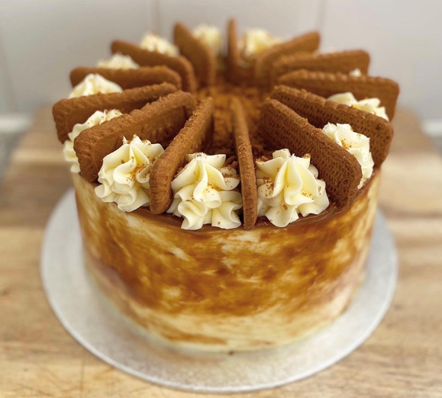
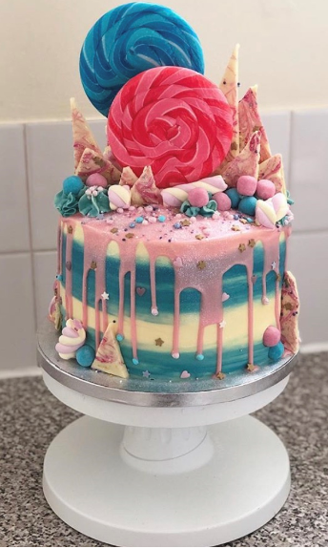
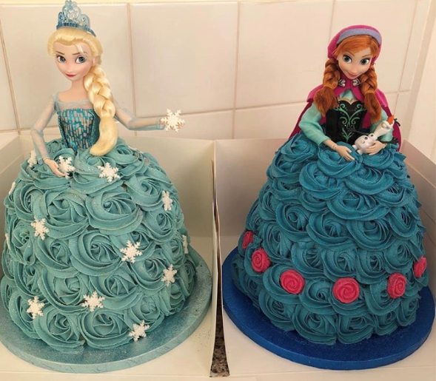
Miss Salt’s Page
Hello 5S, I hope you are all keeping busy and staying safe.
I have been busy practising my baking and decorating skills. It has been challenging at times but I have been resilient and my techniques are improving with every bake!
I have also been exploring my local area and found a beautiful field covered completely in bluebells – it was so lovely that I went back the next day with a picnic!
Here are some photos of some of the cakes I have baked during lockdown, I hope you like them!

Slide 3
Your Name
YOUR IMAGE/S
You do not have to send any images of yourself if you do not wish to.
Your description, explanation or message.
Your caption for your image/s

