Slide 1
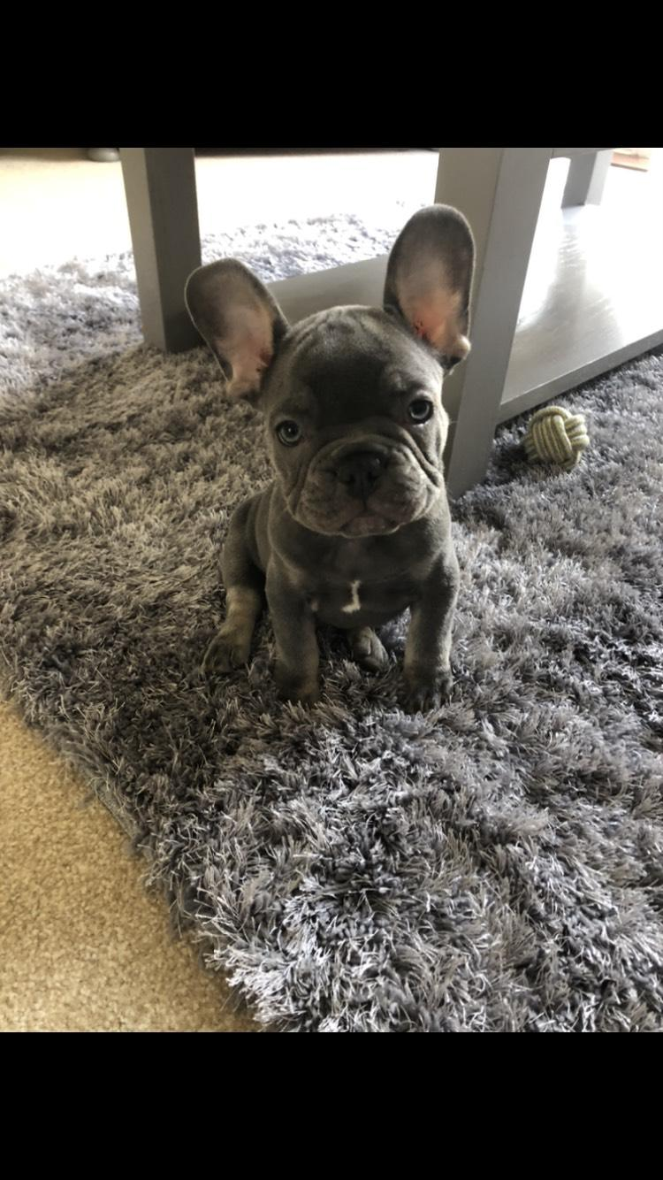
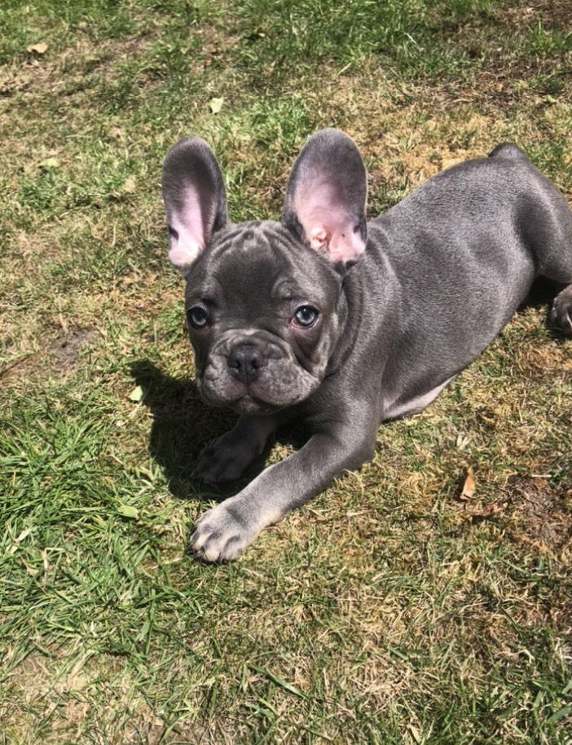
Hello 2A
How are you all?
We haven’t been a class together for a long time now - I miss you! I know you have been busy completing your Year 2 learning and spending time with your families. I have loved seeing all the creative things you have sent in or completed in school - it’s been lovely hearing back from those of you at home. Has any of your learning been added to the QI Gallery on our website?
As well as the learning at home, what have you been doing in your spare time?
Some of you already know this, but for those of you who don’t, I have gained a new best friend. His name is Reggie and he is a French bulldog. He is 10 weeks old and this means I’ll be able to take him for proper walks in two weeks time, perfect timing for the summer holidays!
I have taught Reggie to sit and he is getting better at giving me his paw when I say “High Five.” He will hopefully have it mastered by the next time I see you all.
Have you developed any new skills? What has been your favourite activity in your spare time?
Please send me a slide (like mine – see next slide) with a picture and short description or message that I can share with all the other children in our class. You can change the colours and fonts if you wish. If you cannot use the PowerPoint Slide template, just send me a word document or text in an email with an image. You need to have your parent’s permission if you wish to add any pictures with you (or your family) in them as we will be sharing them with everyone.
Please email your slide to me by Friday this week and I will put all the slides together and email a PowerPoint back to you all full of messages and images from everybody else next week. It’ll be so lovely to have us all back together again (virtually!!).
I look forward to receiving your slides back!
Love from
Miss Atkins

Slide 2
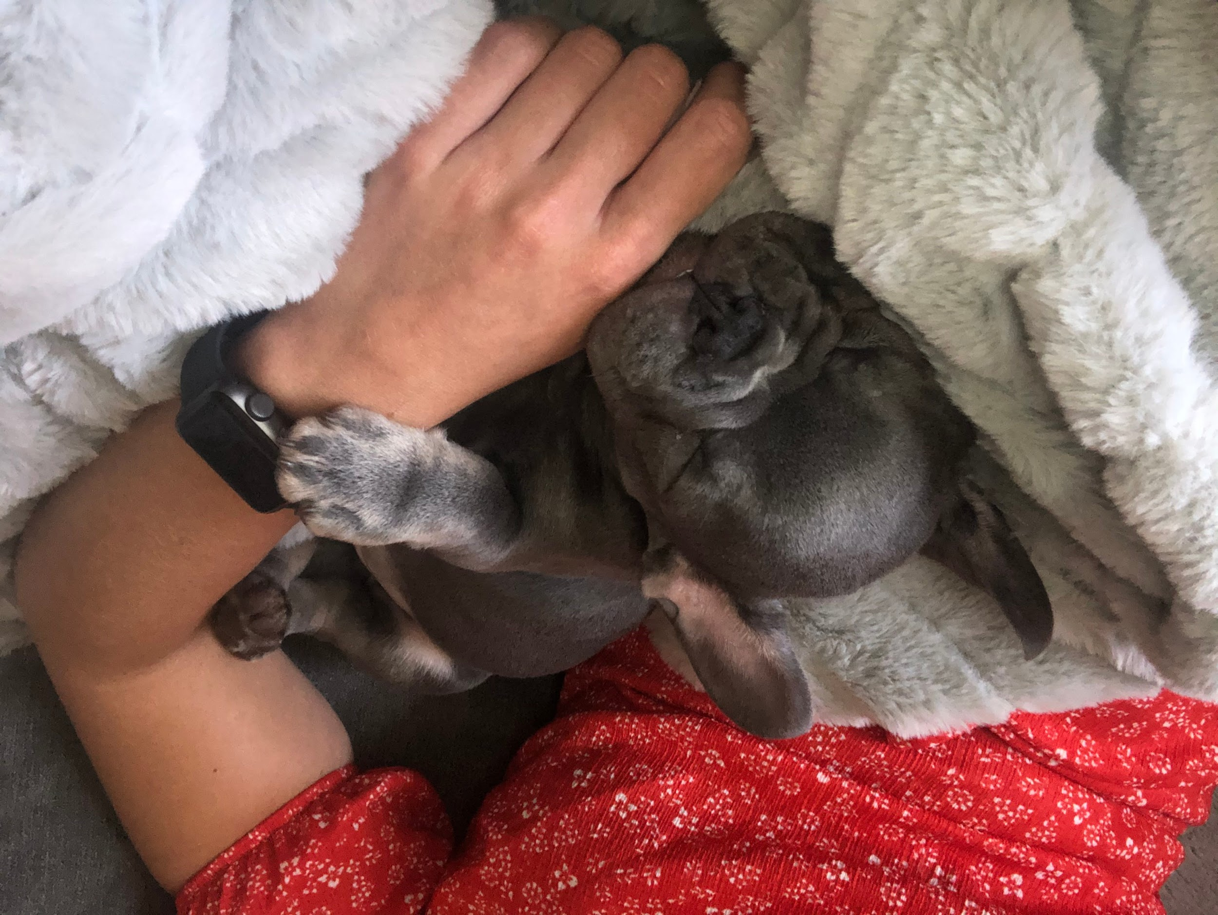
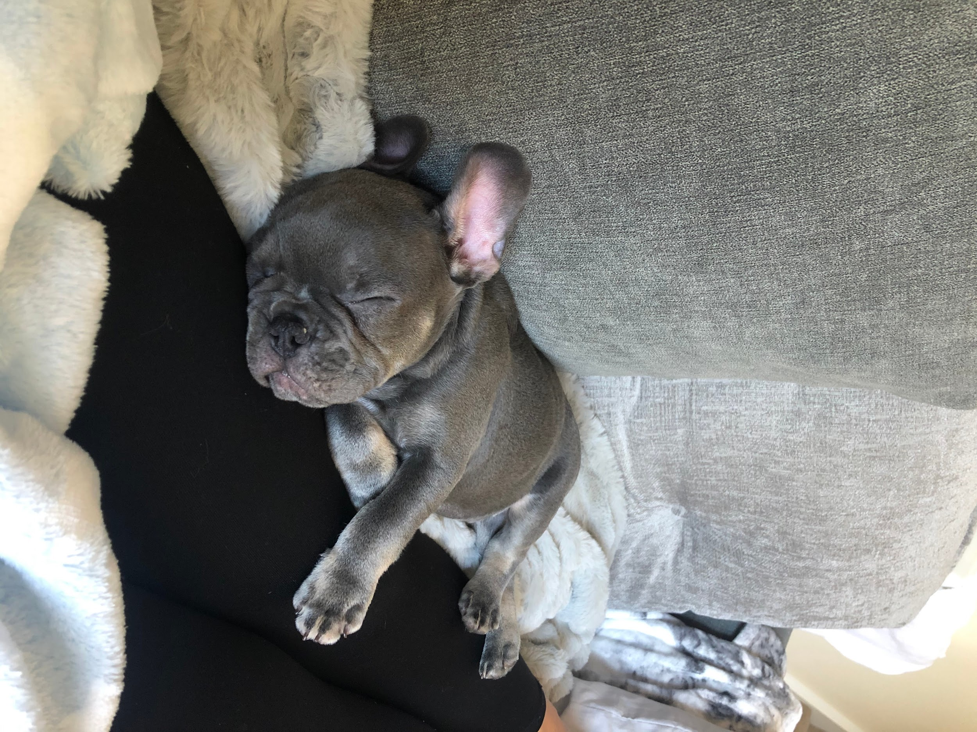
Miss Atkins’ Page
Hello 2A, I hope you are all happy and safe.
My dog’s name is Reggie, and I have been training him to do little tricks.
First of all, I trained him to sit when we are playing and before he has his food.
I am now training him to put up his paw when I say “High Five.”
Where Reggie is still very small, he likes to sleep a lot and we love to get all cuddled up on the sofa when we’re both a bit sleepy.
In the photos are Reggie showing you his cute face and, of course, I had to add a picture of him having a little nap!

Slide 3
Your Name
YOUR IMAGE/S
You do not have to send any images of yourself if you do not wish to.
Your description, explanation or message.
Your caption for your image/s

