Slide 1
Keep Calm and Make Music
Walking the Dog
YR/KS1

Slide 2
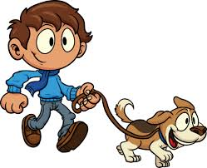
Walking the Dog

Slide 3
Let’s get warmed up!
Follow these links and enjoy tapping along to the steady beat Once confident try different actions to the steady beat e.g. tapping tummies/ thighs/ heads
https://www.youtube.com/watch?v=b1z4JfxFb6c
https://www.youtube.com/watch?v=yi96gfl_Dog

Slide 4
Listen and tap
Listen to this fun piece of music
https://www.youtube.com/watch?v=t67SdkYubs4
Clap along to the steady beat on your thighs

Slide 5
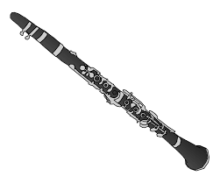
Listen and walk your fingers
Can you hear the walking tune played on the clarinet?
Listen again and make your fingers “walk” every time you hear the clarinet
https://www.youtube.com/watch?v=t67SdkYubs4

Slide 6
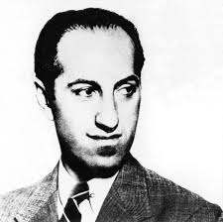
Time for some information
This piece is called:
Promenade – Walking the Dog
It was composed over 80 years ago by George Gershwin

Slide 7
Listen and walk your dog
Take your imaginary dog for a walk What do you think he gets up to during his walk?
https://www.youtube.com/watch?v=t67SdkYubs4

Slide 8
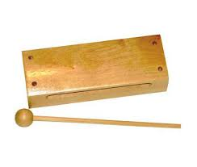
Using word patterns
Explore chanting these word patterns in time to the music
Once confident try clapping these word patterns then playing them on wooden or skinned instruments
Dog | walking
Walking | walking
Walking | dog

Slide 9
Use your imagination!
Work together to create a sequence of events to go with the music e.g.
Music | Actions
Introduction | Stretching ready for the walk
Clarinet tune | Walking down the street
Busy swirling sounds | Pause whilst dog chases its tail
Clarinet tune | Walking
Busy swirling sounds | Dog chases its tail again
Clarinet tune | Walking
Violin tune | Stopping to chat to a friend
Introduction | Waving goodbye to a friend
Clarinet tune | Walking
Busy swirling sounds | Dog chases its tail again (but is tired now)
Clarinet tune | Walking home – getting more and more tired

Slide 10
Remember your ideas
Draw a simple picture to help you to remember each of your ideas e.g.

Slide 11
Mime to the music
Mime each of your chosen events along to the music Use your pictures (holding them up one at a time) to remember what to do when
https://www.youtube.com/watch?v=t67SdkYubs4

Slide 12
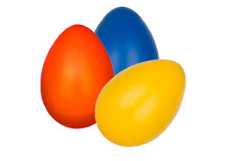
Play along to the music
Find a sound to go with each of your pictures e.g. you could play walking sounds on a wood block or chasing your tail sounds on shaky eggs
Play your sounds along to the music (still using your pictures to remember what to do when)
https://www.youtube.com/watch?v=t67SdkYubs4

Slide 13
Still got time?
Work in small groups to create your own
Walking the Dog pieces of music
Plan what’s going to happen Draw a picture for each event including walking
Create a walking theme
Create sounds for the other events Rehearse Perform Record

