Slide 1
Keep Calm and Make Music
Weekly Wonder
Colours of the Rainbow - for YR and KS1

Slide 2
Colours of the Rainbow
KS1

Slide 3
Do you know the colours of the rainbow? (click to find out if you are right)
Red
Yellow
Orange
Green
Indigo
Blue
Violet

Slide 4
Can you sing a rainbow?
Click to Sing a Rainbow
Learn the makaton signs for the colours in
Sing a Rainbow with Mr Tumble
and Sing a Rainbow with Fairy Sarah
You can practise the song lots of times click here
Sing a Rainbow with words on repeat

Slide 5
Can you sing the colours verse off by heart?
Can you add the makaton signs as you sing?
(Go back and watch Mr Tumble or Fairy Sarah again)
Why don’t you film yourself on the iPad and send it to some family members or just perform live for your family

Slide 6
Rainbow colours are everywhere
How many red things can you think of?
Click three times to get started
Draw or make a list of red things, look round the room you are in or out of the window. You could use a red pen or crayon to make your list

Slide 7
Rainbow colours everywhere
Can you find something to match every colour of the rainbow?
Listen to this Rainbows Colours Song for some ideas
Why not make a list of things for each colour of the rainbow

Slide 8
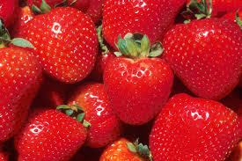
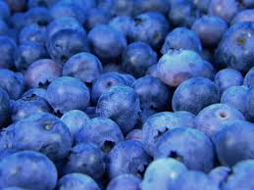
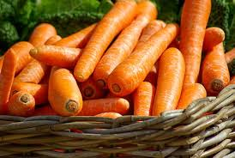
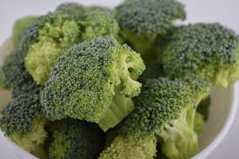
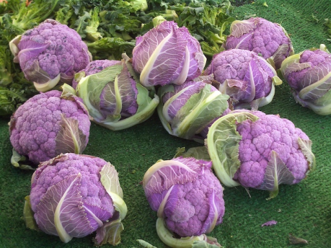
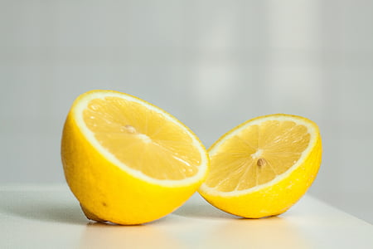
A rainbow of fruit and vegetables
Can you think of a fruit or vegetable for each colour of the rainbow?
Here are some to get you started (click 6 times)

Slide 9
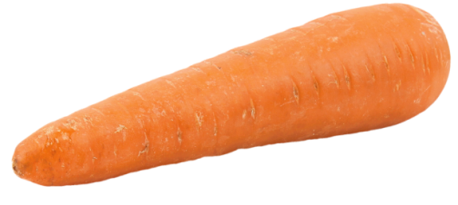
Make a rainbow of fruit and vegetables
Can you make a rainbow of fruit and vegetables?
You could draw some pictures
or cut some pictures out of a magazine
or even use real fruit and vegetables
(if you do this one take a photograph of it)
BUT always ask a grown up to help you

Slide 10
Let’s make some rainbow music - To make a rainbow there needs to be rain and sun together so……………………………
To make your rainbow music you will need a rain sound, a sun sound and a rainbow sound
Click on each sound in turn then choose your favourite rain sound, sun sound and rainbow sound
To make your rainbow music play the sounds one after the other or all at the same time to create your rainbow music
e.g. rain 1 + sun 2 together for a count of 5, then add rainbow 1 for a count of 3, the stop the sun, stop the rainbow, stop the rain
Choose one of these Choose one of these Choose one of these
rain sounds sun sounds rainbow sounds
rain 1 or rain 2 sun 1 or sun 2 rainbow 1 or rainbow 2

Slide 11
Now for a bit of science and some facts about rainbows
Click on this link to hear
Dr Binocs explain how a rainbow is formed
And click on this link to read some interesting
Rainbow facts (ask a grown up to read some facts for you if there is too much writing!)
e.g. Did you know rainbows are a full circle?

Slide 12
Here are some more songs about colours for you to enjoy listening to
Here is another song about the colours of the rainbows for you to listen to and join in
Rainbows Colours Song 2
Look at your lists, drawing and photos as you listen
What is your favourite thing of each colour of the rainbow?
Click here for a song called Rainbow Connection from Kermit the Frog
Listen to this song all about lots of different colours
Look at All the Colours I can See

Slide 13
Congratulations you can sing, play and make rainbows!

